Slide 1
The top Mistake with Infection Control and OSHA Compliance
Presented by: Abby Teh DMD, RDA,CDA.OA

Slide 2
#1 Not having a written program

Slide 3
Written Hazard Communication Plan
The written program must describe how your compliance system works.
It must include information about access to safety data sheet, labeling, personal protective equipment and provisions for the training of employees.

Slide 4
Hazard Communication Program
OSHA issued the Hazard Communication Standard because employees have the right to know the identity and hazards of chemicals that they use in the workplace
Also known as the Employee Right-to-Know Law
Requires employers to implement a hazard communication program

Slide 5
Hazard Communication Standard
Employer responsibility under the Hazard Communication Standards
Hazard classification
Chemicals are classified into categories that compare hazard severity within a hazard class. Each chemical that falls into the same category will have the same label requirements and language
Labels
All labels will now include a harmonized signal word, pictogram, and hazard statement for each hazard class and category
Safety Data Sheets
Will now have a specified 16-section format
Creating and implementing an employee training program
Developing, implementing, and maintaining a written hazard communication program

Slide 6
Chemical Inventory List
Required list of all hazardous chemicals/materials in the office
Update new chemicals/products are received
Placed within the compliance manual and posted in a prominent area in the office

Slide 7
Workplace Labeling
Requirements for workplace labeling:
GHS compliance labels are recommended for consistency
Product on their original containers normally have adequate labeling and do not need relabeling
Unmarked containers must have labels placed on them
Train employee to understand how to read labels

Slide 8
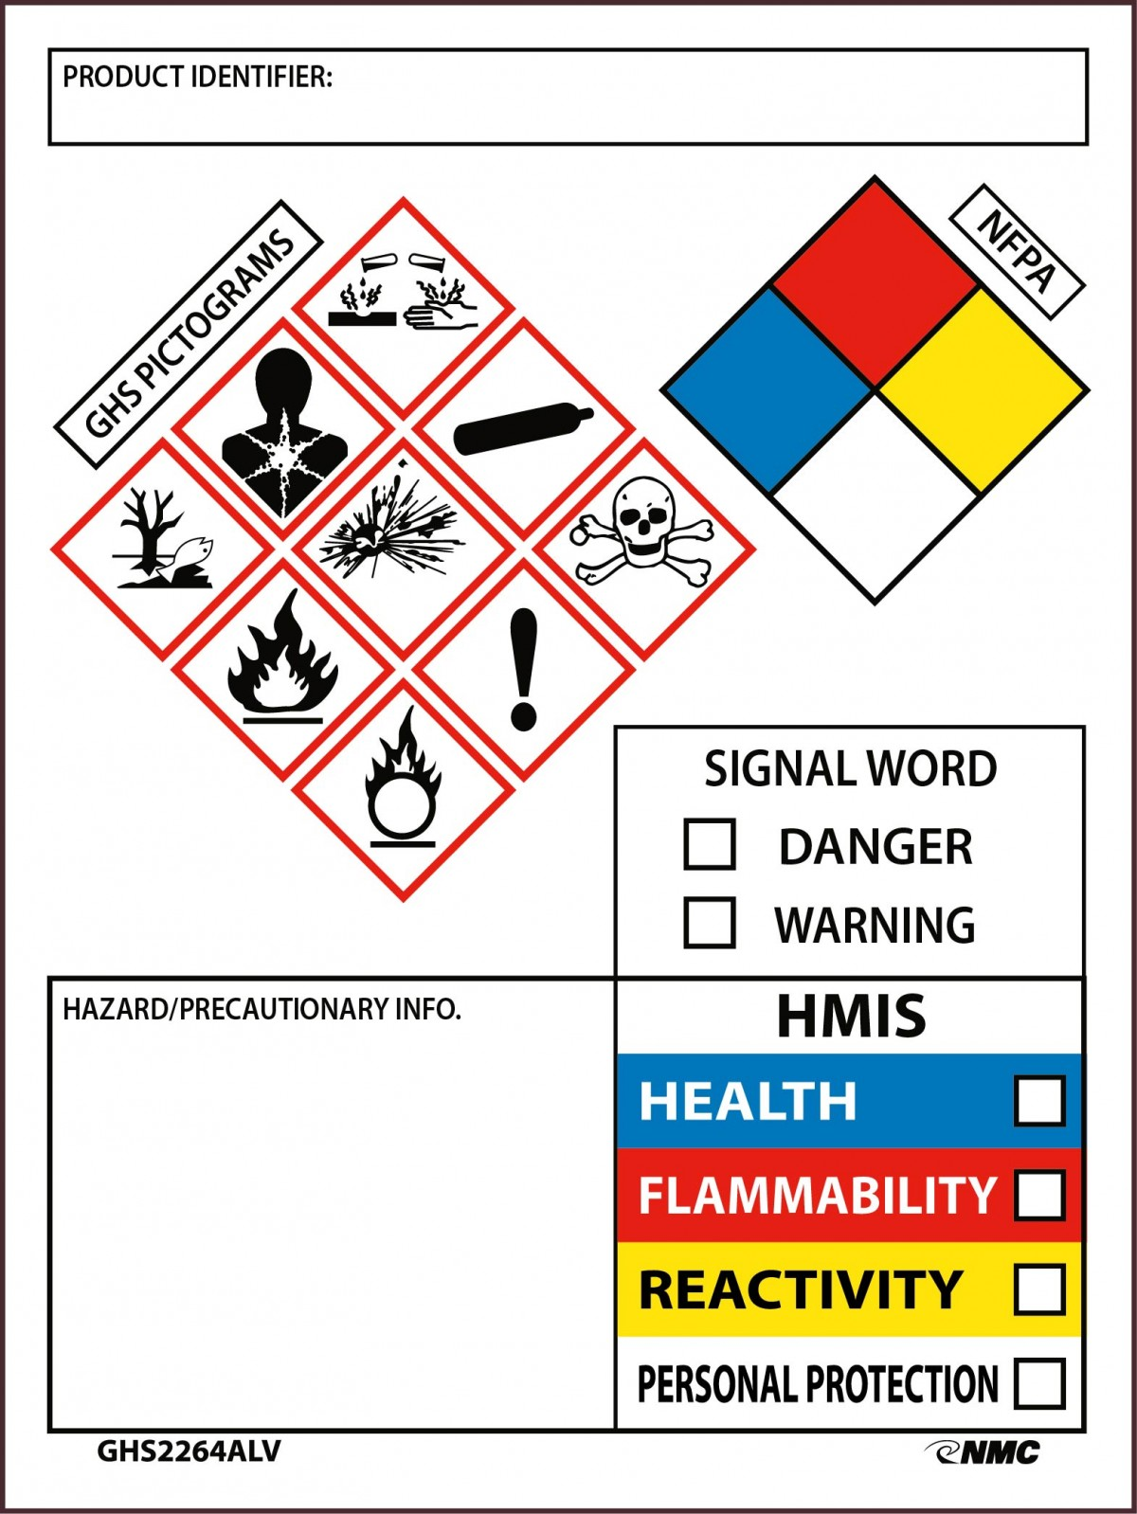
Revision of the HCS Standard
In 2012, OSHA revised the HCS and adopted the Globally Harmonized System of Classification and Labelling of Chemicals (GHS)

Slide 10
# 2 Missing Safety Data Sheet(SDS) or poorly organized SDS that cannot be accessed in the event of an emergency

Slide 11
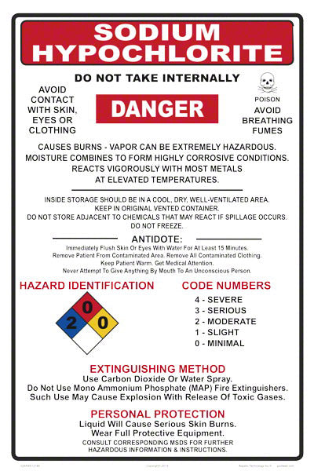

Slide 12
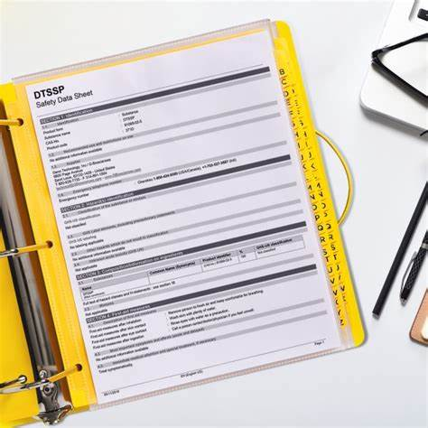
SAFETY DATA SHEET DOCUMENTATIONS
Designate a person to be responsible for obtaining and maintaining SDS
Must maintain SDS for 30 years from the last date used
Require for all hazardous chemicals/materials used in your facility
Must be available for all employees

Slide 13
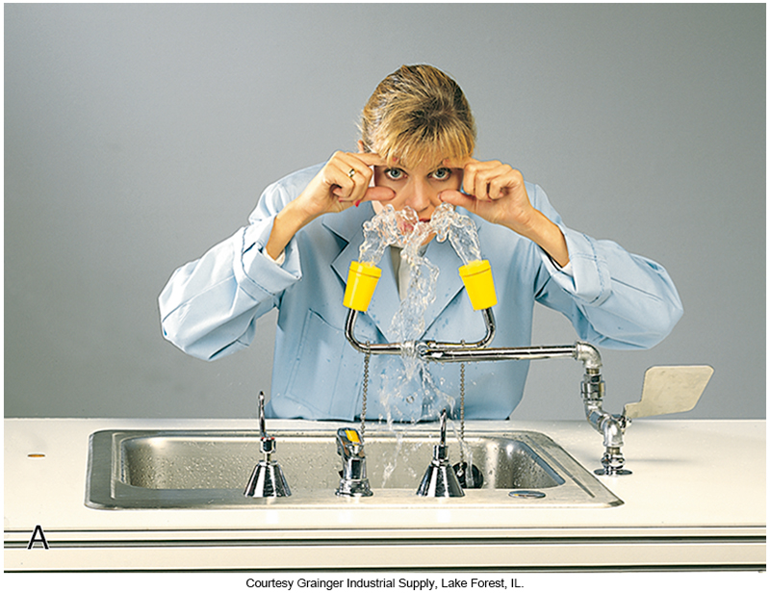
An eyewash station must be accessible for all employees
Must be within 55 feet of any chemical hazard
Must be inspected and activated weekly. Run10 to 15 seconds.
Assign an employee to do this
Record/ document the inspection
#3 Having no eyewash or having an eyewash that is not accessible or functioning

Slide 14
# 4 Not offering exposed employees the Hepatitis B vaccine and/ or not having a signed declination form for those who do not want the vaccine

Slide 15
Hepatitis B (HBV)
HBV is a virus that can cause an inflammation of the liver that may lead to liver damage and death
Can survive outside the body at room temperature for 7 days
Hepatitis B is 100 times more transmissible than HIV
Immunization is available and recommended
Hepatitis B cannot be cured

Slide 16
Exposure Control Plan: Hepatitis B Vaccination Requirements
OSHA requires the dentist to offer the hepatitis B virus (HBV) vaccination series to all employees whose jobs include category I and II tasks.
Vaccine must be offered within 10 days of employment.
The dentist/employer must obtain proof from the physician who administered the vaccination.
The employee has the right to refuse the HBV vaccine; however, the employee must sign an informed refusal form that is kept on file in the dental office.
The employee always has the right to change his or her mind and receive the vaccine at a later date at no charge.

Slide 18
#5 Not providing baseline TB testing for all employees and new employees
Employees must have base line test for TB upon employment and it’s only one time.
Employee that had a needle stick accident or some occupational injury.

Slide 19
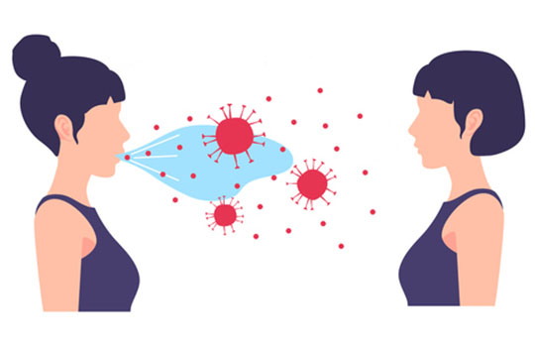
Tuberculosis (TB)
Airborne – NOT bloodborne
Spread by inhaling respiratory droplets from
Coughing
Speaking
Laughing
Sneezing

Slide 20
The most Common Symptoms of TB disease
Fatigue
Fever
Weight loss
Night sweats
Chills
Chronic cough
Coughing up blood and mucous

Slide 21
TB Risk Categories
Low risk facilities
Patient with TB are likely to be seen
Most dental offices are considered low risk
Employee should have a baseline test only
Medium risk facilities
Likely to see patient with TB
Should have a baseline and an annual TB test performed

Slide 22
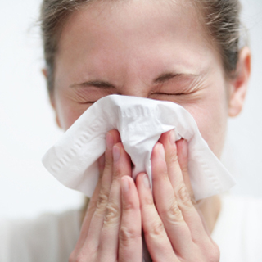
Measures to Contain Respiratory Secretions
Cover mouth and nose with a tissue when coughing or sneezing.
Use the nearest waste receptacle to dispose of tissues after use.
Perform hand hygiene after having contact with respiratory secretions and contaminated objects or materials.
Offer masks to coughing patients and other symptomatic people when they enter the dental setting.
Encourage people with symptoms to sit as far away from others as possible.

Slide 23
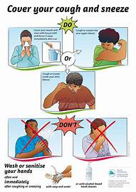
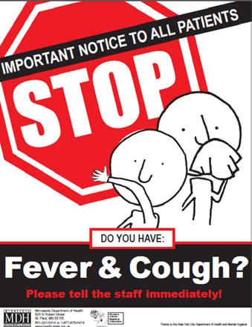
Visual Alerts
Display visual cues to remind staff and patients of proper ways to prevent spread of respiratory pathogens.
Related materials are available at Cover Your Cough and Important Notice to All Patients

Slide 24
#6 Not providing training for employees

Slide 25
Employee Training
Staff training is required:
When a new employee is hired
When a new chemical product is added to the office
Once a year for all continuing employees
Records of each training session must be kept on file
Training records are to be retained for at least 5 years

Slide 26
Training Records
Training records must include the following:
Dates of the training session
Content or a summary of the training session
Name of the person conducting the training
Name of the trainee
Give individual certificate of training each person

Slide 27
#7 Failure to provide exposure treatment and counseling to exposed employees

Slide 28
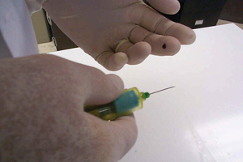
Accidents happen!
Before an accident occurs, the BBP requires the employer to have a written plan.
This plan explains exactly what steps the employee must follow the exposure incident occurs and the type of medical follow-up that will be provided to the employee at no charge.

Slide 29
Exposure Control Plan: Exposure Evaluation and Follow-Up
Post exposure would care:
Immediately notify your supervisor
Wash needles sticks, cut and exposed skin with soap and water
If nose or mouth splashed- flush with water
If eye have been splashed – irrigate with water using your eyewash

Slide 30
Exposure Control Plan: Exposure Evaluation and Follow-Up
Written Incident Report:
Date and time of exposure
Procedure details: what, where, and how
Exposure details: entry route, fluid involved, volume/duration of contact
Information about source person and exposed person
Before an exposure incident occurs, identify an occupational medicine clinic in your area who you will refer to

Slide 31
Exposure Control Plan: Exposure Evaluation and Follow-Up
Post-exposure evaluation and follow up
Identification and testing of the source patient for HBV,HCV, and HIV
Collecting and testing the exposed worker’s blood
Offering post-exposure prophylaxis and counseling
Evaluation of reported illness
Source individual’s test result made available to the exposed employees
Have all blank post-exposure forms “ready-to-go” before an accident occurs!

Slide 32
Exposure Control Plan: Post Exposure Evaluation and Follow-Up
After the employee has received post-exposure follow-up, the employer will obtain a written opinion from the healthcare provided and provide it to the employee within 15 working days
Written opinion for post-exposure evaluation and follow-up include information that the employee has been:
Informed of the evaluation result, and
Informed of any medical conditions that require further treatment

Slide 33
#8 Not having a Written Exposure Control Plan

Slide 34
Written Exposure Control Plan
Required in the plan
Identification of hazards in the workplace
Identification of which task could expose employees
Identification of which employees may have potential exposure
Identification of appropriate personal protective equipment (PPE)
Training of employees on use and care of PPE

Slide 35
Written Exposure Control Plan
Required in the plan
Implementation of various methods of exposure control such as:
Standard precaution
Engineering and workplace controls
Housekeeping
Access to receiving the Hepatitis B
Process of post-exposure evaluation and follow-up
Recordkeeping

Slide 36
Exposure Control Plan: Standard and Universal Precautions
Universal precautions is based on the concept that all human blood and body fluids (including saliva) are to be treated as if known to be infected with the bloodborne disease, HBV, HCV, or HIV.
The CDC expanded the concept and changed the term to Standard Precautions.
Standard Precautions integrate and expand the elements of Universal Precautions into a Standard of Care designed to protect healthcare providers from pathogens that can be spread by blood or any other body fluid, excretion, or secretion.
It is not possible to identify those individuals who are infectious, so infection precautions are used for all healthcare personnel and their patients.

Slide 37
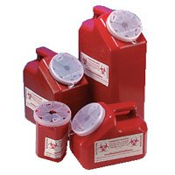
Exposure Control Plan: Engineering Controls
Whenever possible, engineering controls should be the primary method to reduce exposure to bloodborne pathogens.
These controls remove or isolate the hazard.
They are frequently technology-based, for example: Self-sheathing anesthetic needles, safety scalpels, and needleless IV ports.
Sharps containers and needle recapping devices.

Slide 38
Managing Contaminated Sharps
Contaminated needles and other disposable sharps, such as scalpel blades, orthodontic wires, and broken glass, must be placed into a sharp's container.
The sharps container must be puncture-resistant, closable, leak-proof, and color-coded or labeled with the biohazard symbol.
Sharps containers must be located as close as possible to the place of immediate disposal.
Do not cut, bend, or break the needles before disposal.
Never attempt to remove a needle from a disposable syringe.

Slide 39
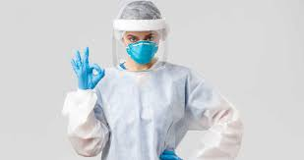
Personal Protective Equipment
OSHA requires the employer to provide employees with the appropriate PPE without charge to the employee
Examples of PPE
Protective clothing
Surgical masks
Face shields
Protective eyewear
Disposable patient-treatment gloves
Heavy-duty utility gloves

Slide 40
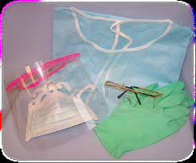
Masks, Protective Eyewear, Face Shields
Wear a surgical mask and either eye protection with solid side shields or a face shield to protect mucous membranes of the eyes, nose, and mouth.
Change masks:
- Between patients.
- If mask becomes wet during patient treatment.
Clean reusable face protection:
- Between patients (with soap and water).
- If visibly soiled (by cleaning and disinfecting).

Slide 41
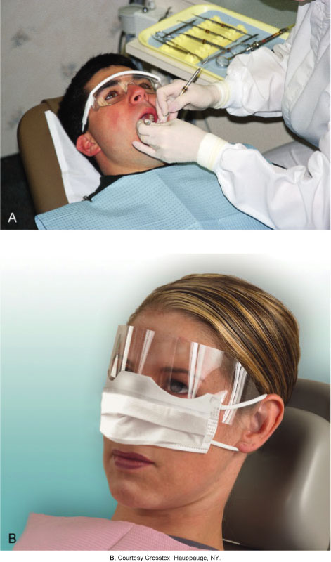
Patient Safety Eyewear
Patient eye protection is the standard care! Make sure all patients wear protective eyewear when they having dental treatment.

Slide 42
CDC’s PPE Recommendations for Dental Setting
For procedures likely to generate splashes: gloves + eye protection + gown (or protective clothing) + surgical mask
For aerosol generating procedures: gloves + eye protection + gown + N95 or higher-level respirator (instead of surgical mask)

Slide 43
Utility Gloves
Utility gloves are not used for direct patient care
Utility gloves must be worn:
When the treatment room is being cleaned and disinfected between patients
While contaminated instruments are being cleaned or handled
For surface cleaning and disinfection
Utility gloves may be washed, disinfected, or sterilized and reused
Used utility gloves must be considered contaminated and handled appropriately until they have been properly disinfected or sterilized

Slide 44
# 9 COVID RELATED
Not conducting fit testing of respirators
Having no written Respiratory Protection Plan
Not having a medical evaluation for those employees who wear respirators

Slide 45
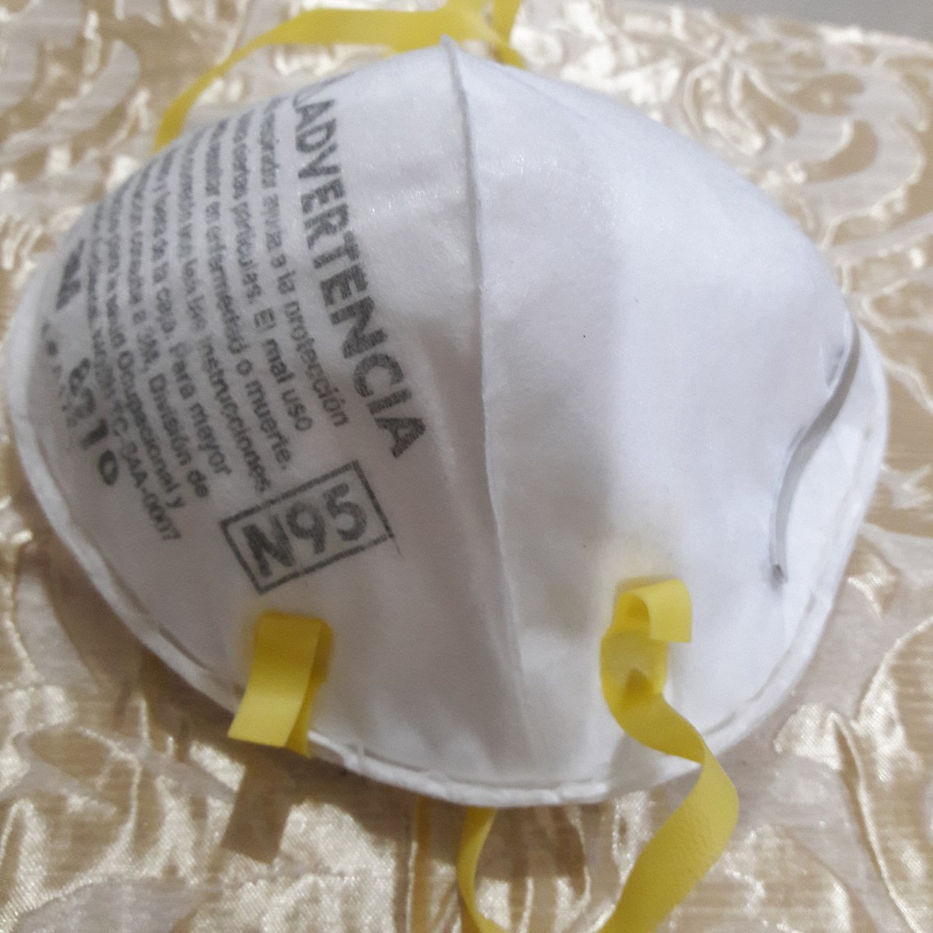
Do Dental Offices Need N95 Mask?
N95 mask are considered “respirators by OSHA and have strict requirement which include having a written respiratory protection plan, fit testing, and a medical evaluation of those individuals who will wear them
Should be used during the COVID_19 pandemic if doing an aerosol procedure on a patient NOT suspected of having a COVID-19 infection.
This means if you operate a high- or low-speed handpieces , an ultrasonic scaler, or use an air/water syringes, you should be using an N95 mask, as these procedures have potential to generate aerosol.
Remember, we should NOT be treating “known or suspected COVID-19 patient in your office, as they should be treated in a special facility with negative air pressure isolation.

Slide 46
Roles and Responsibilities of the CDC and OSHA in Infection Control
Federal agencies that play important roles in infection control for dentistry
The Centers for Disease Control and Prevention (CDC)
The Occupational Safety and Health Administration (OSHA)
The CDC is not a regulatory agency
Issues specific recommendations based on sound scientific evidence on health-related matters
Establishes a standard of care for the dental profession
Notes:
For guidance on recommendations for infection control concerns, contact the Centers for Disease Control (CDC).

Slide 47
OSHA Regulations & CDC Guidelines
Following OSHA regulations and CDC guidelines has always been important
Continue to provide annual required OSHA training to all employees
Provide training to all new employees as part of the onboarding process.

Slide 48
OSHA Training Records
Training records must include the following:
Dates of the training session
Content or a summary of the training session
Names and qualifications of persons conducting the training
Names and job titles of the all attending the training sessions
Training records must be maintaining for 3 years from the date on which the training occurs

Slide 49
OSHA Inspections: What to Expect
Inspectors will typically:
Ask for the OSHA Manual/Written Documents, including:
- Written hazard communication plan, SDS binder, written exposure control plan and training records
2. Check for posting of required documents
3. Interview employees
4. Inspect the facility for compliance with OSHA standards
5. Comment on and note hazards present
6. Send the result several weeks later
7. Citations may contest.

Slide 50
CDC Guidelines
OSHA can enforce CDC guidelines, even though they are written by the CDC
OSHA Enforces then under a section of the OSHA regulation called the “General Duty Clause”
State Dental Boards and Public Health can enforce them as well
The public and courts of law expects us to be following them

Slide 51
Dental Office Surface Asepsis
Barriers
Chemical surface disinfection
Ultraviolet disinfection

Slide 52
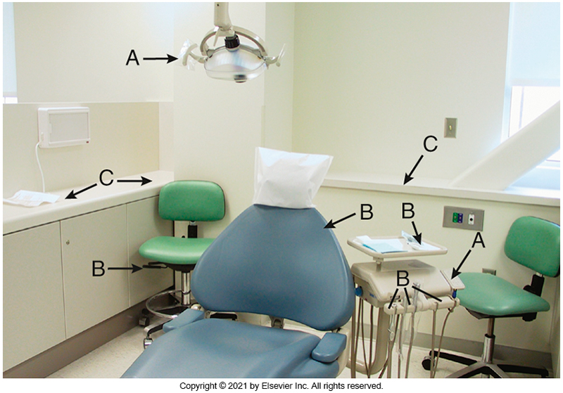
Simplify Surfaces
Don utility gloves, face protection
Touch surfaces (A); transfer surfaces (B); and splash, spatter, and droplet surfaces (C).

Slide 53
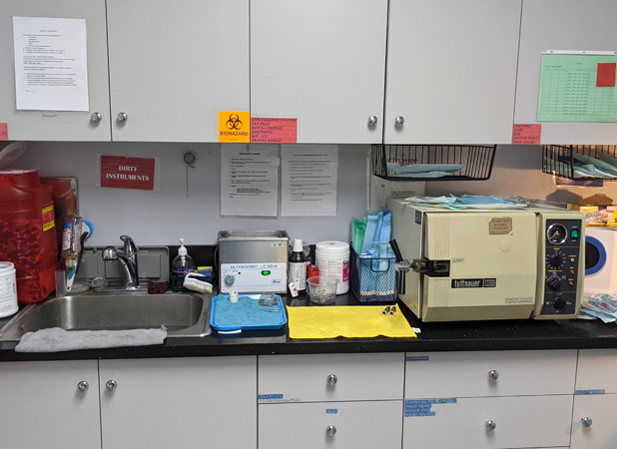
Removing Clutter

Slide 54
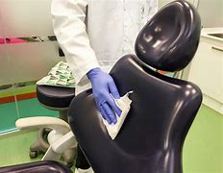
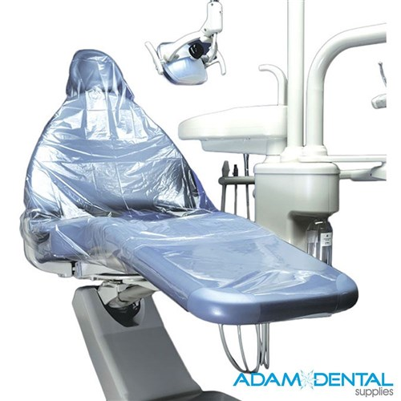
OPERATORY ASEPSIS
TWO CHOICES:
COVER IT
CLEAN AND DISINFECT IT

Slide 55
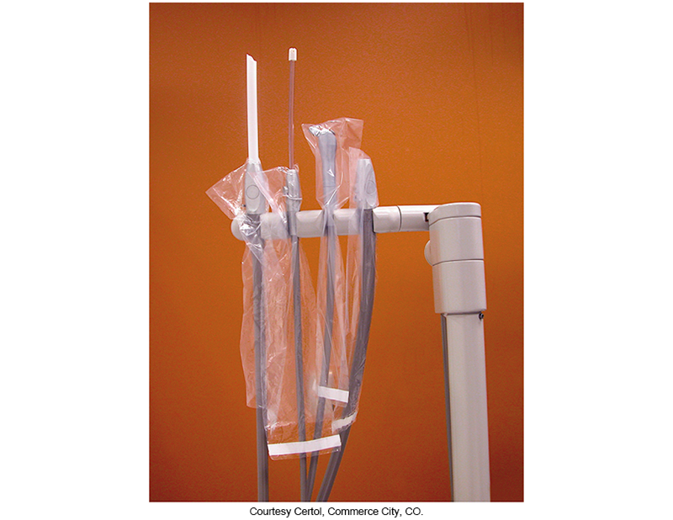
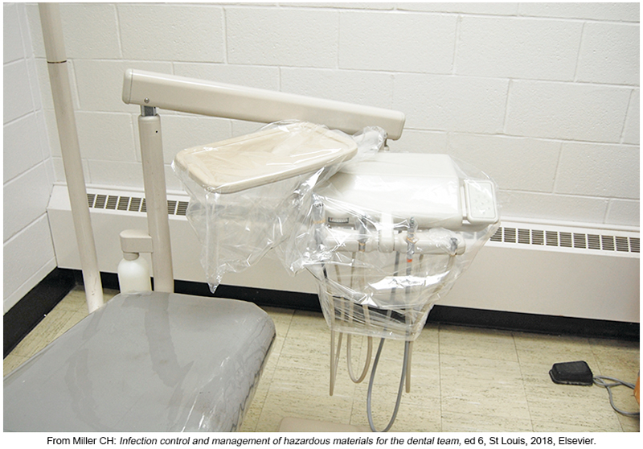
COVER IT
Barriers on control unit and instrument tray holder.
Disposable sleeves provide barrier protection for difficult-to-clean areas.

Slide 56
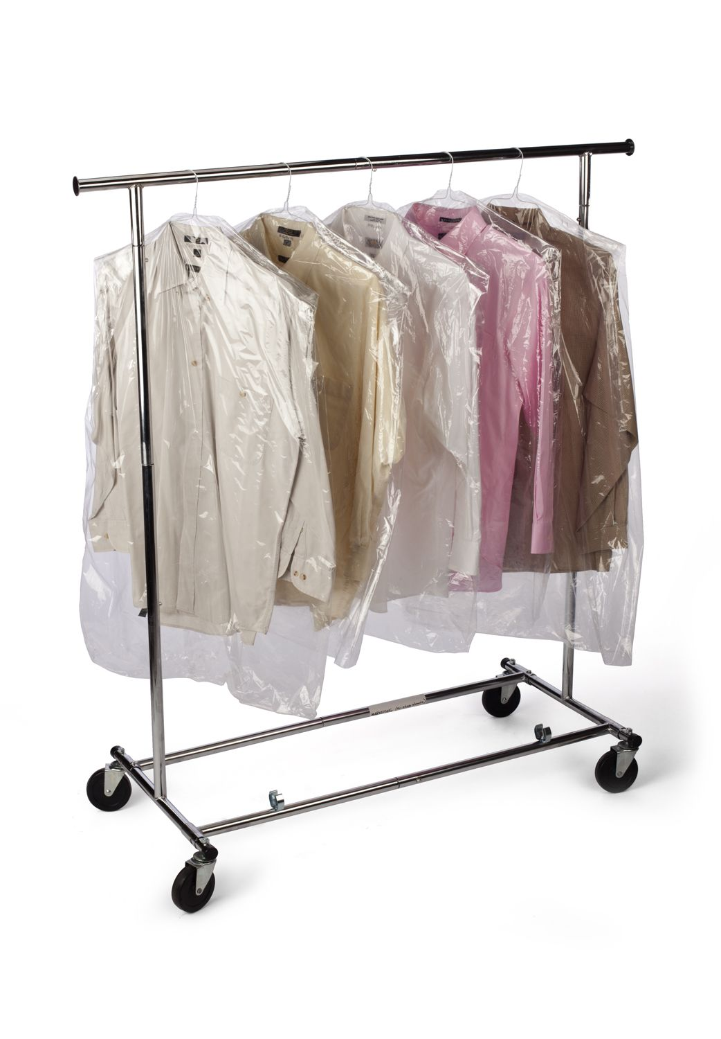
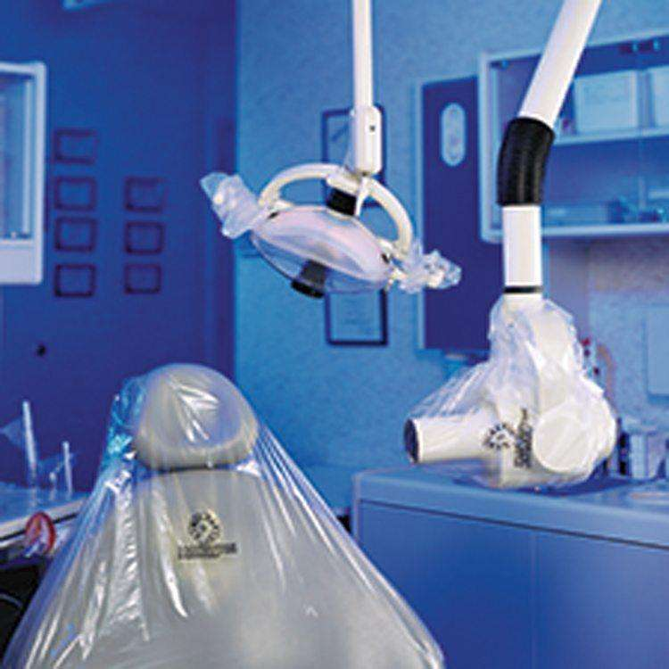
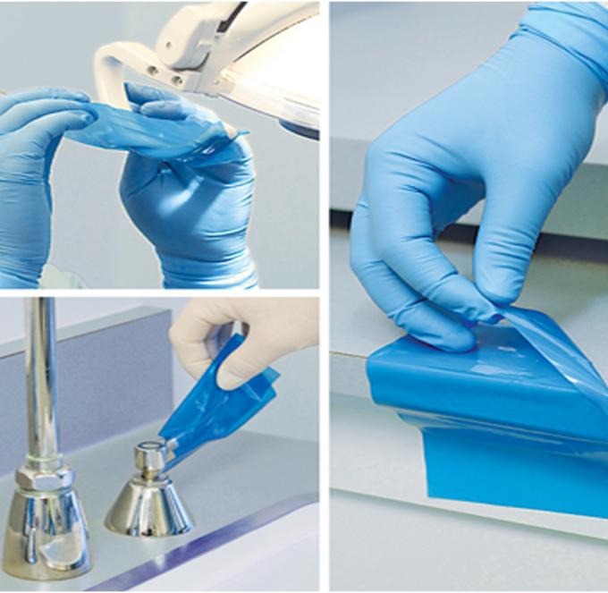
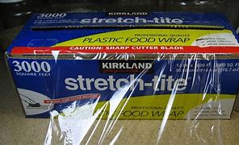
USE FDA CLEARED MEDICAL GRADE BARRIERS
Tested for Viral & Bacterial Penetration

Slide 57
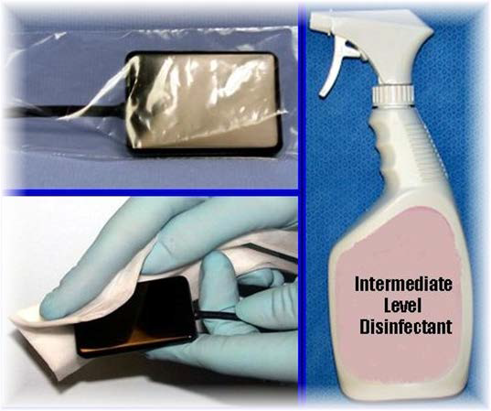
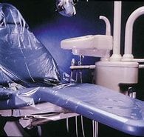
BARRIERS PREVENT CONTAMINATION OF HARD-TO-CLEAN SURFACES
UPHOLSTERY
ELECTORONICS
CHANGE EVERY PATIENT
DIGITAL SENSORS: SEMI-CRITICAL

Slide 58
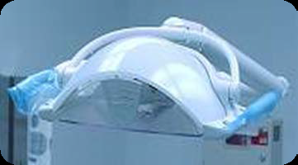
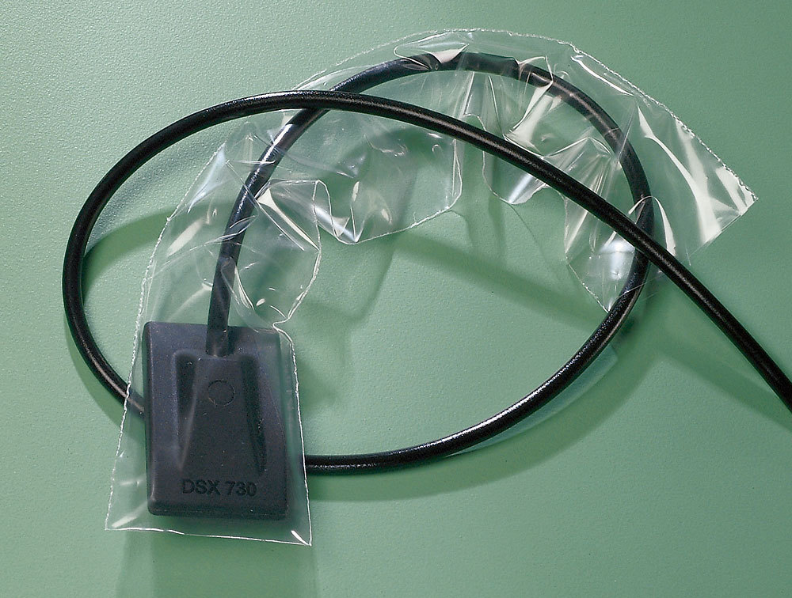
MUST YOU DISNFECT WHEN CHANGE BARRIERS?
Wipe if contaminated Wipe Must be wipe with
intermediate-level disinfectant

Slide 59
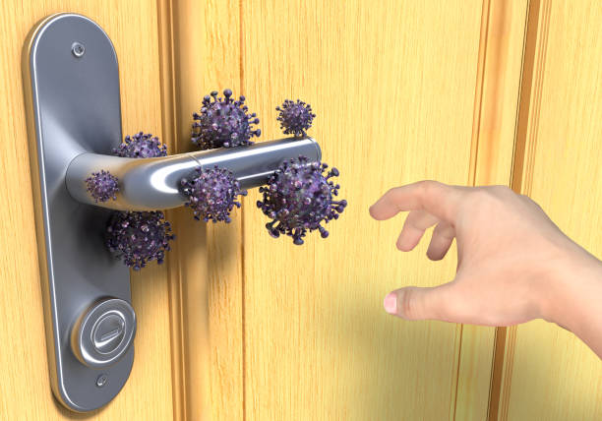
PRODUCT SELECTION AND STRATEGIES
EPA intermediate level disinfectant – operatories
EPA list of SARS CoV-2 disinfectant
https://www.epa.gov/coronavirus/about-list-n-disinfectants-coronavirus-covid-19-0
Extended area & frequency of disinfection protocol – all touch/ transfer surface.
Weekly deep cleaning – remove chemicals & dry biofilms
Cleaning is essential!
Disinfectant fails on unclean surfaces

Slide 60
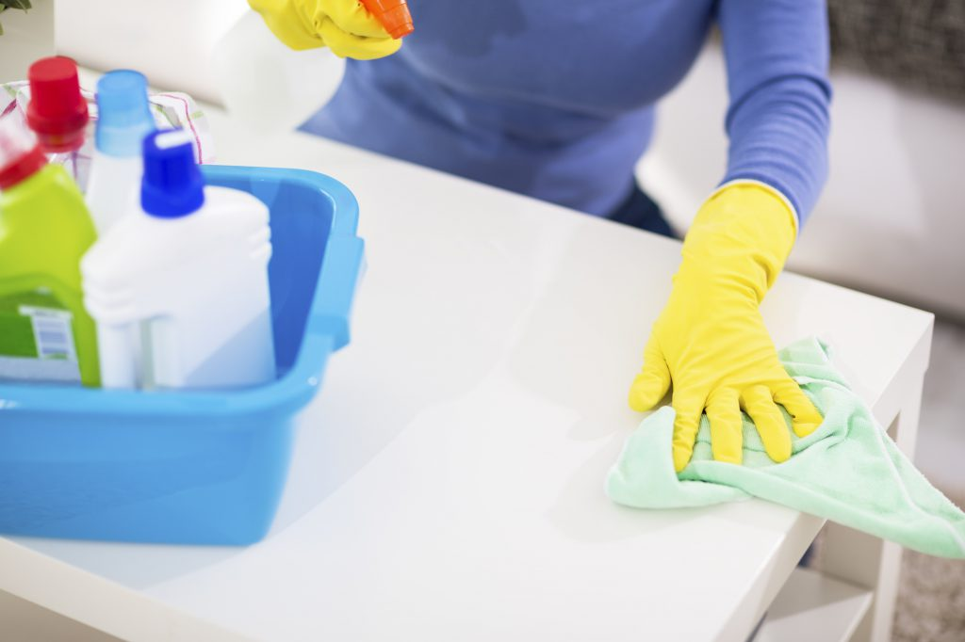
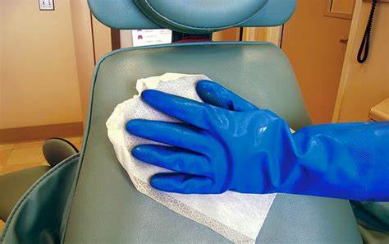
ARE YOU CLEANING BEFORE DISINFECTING???
IF DEPEND ON TECHNIQUE AND PRODUCT SELECTION

Slide 61
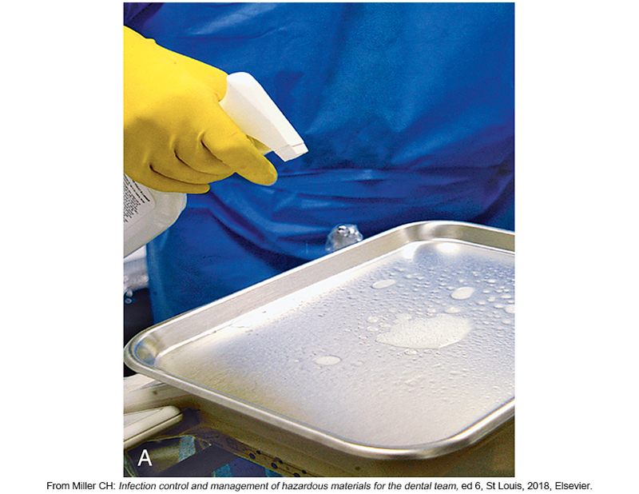
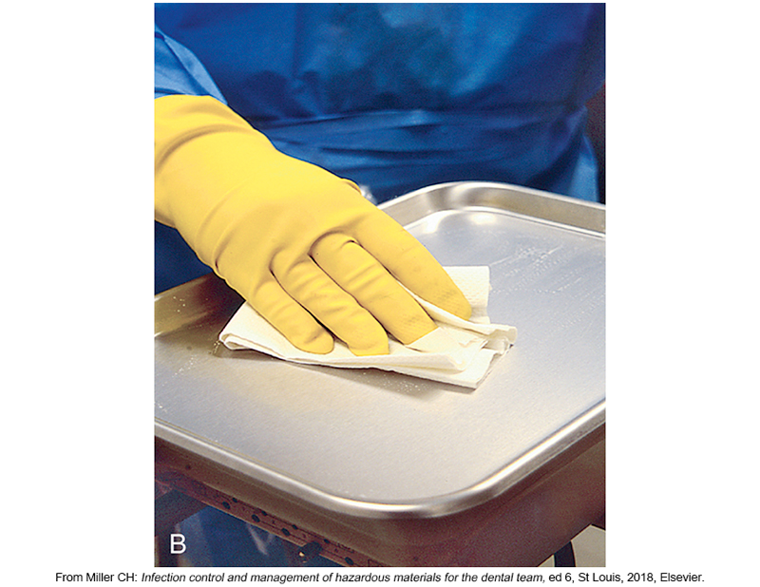
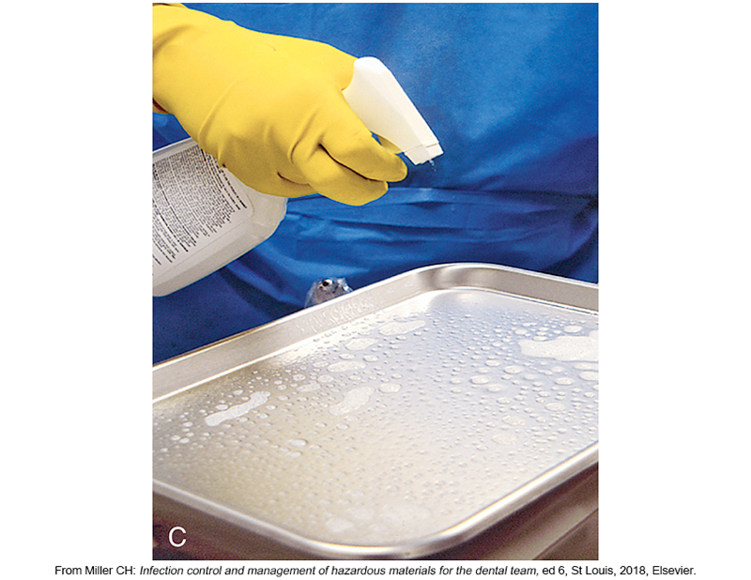
CLEAN & DISINFECTING – 2 STEPS
CLEANING DISINFECTING
SPRAY WIPE SPRAY

Slide 62
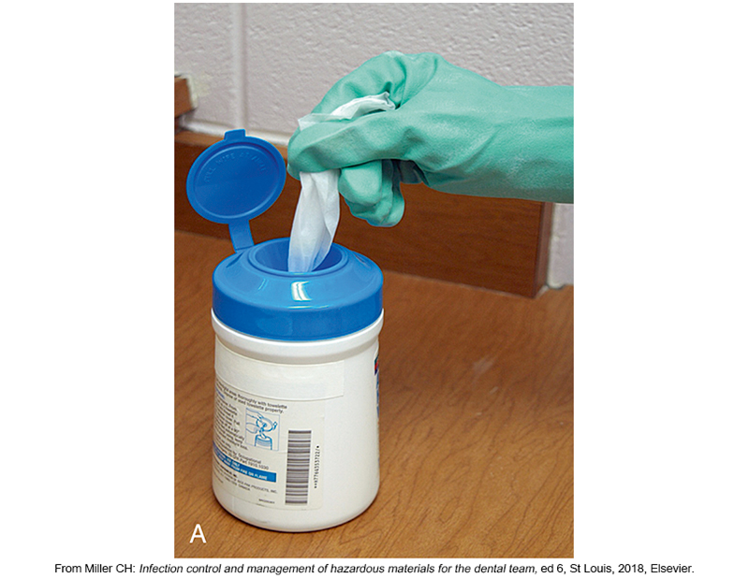
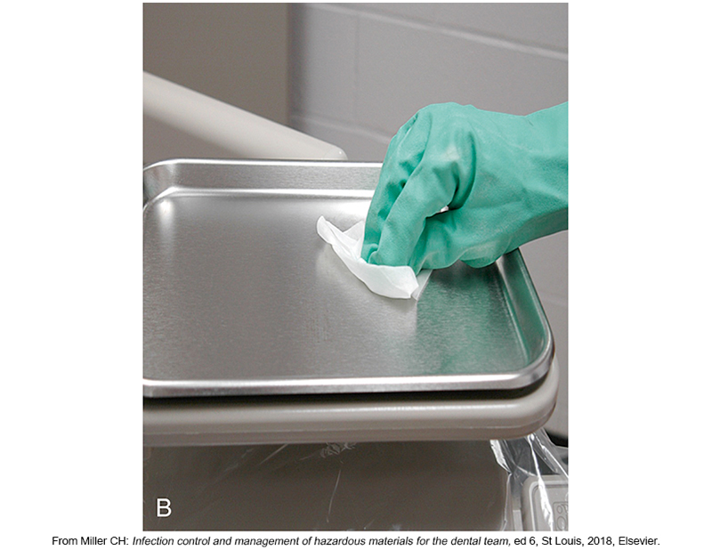
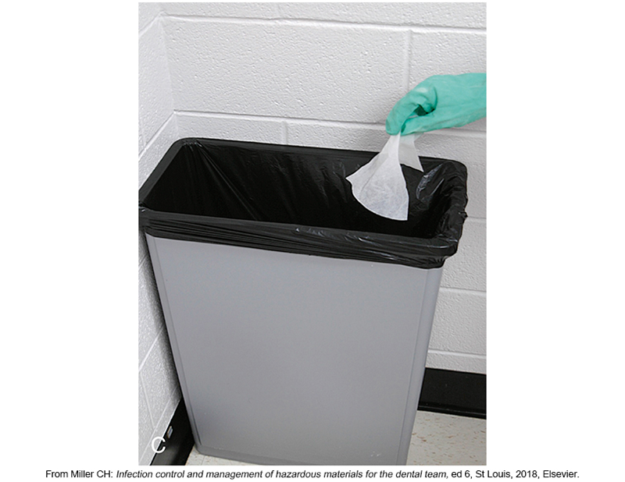
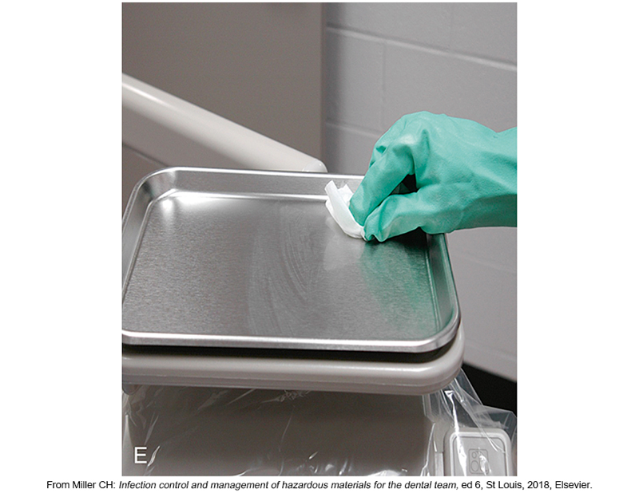
CLEAN BEFORE DISINFECTING
Surface precleaning and disinfecting by the wipe-discard-wipe technique. Precleaning consists of (A) obtaining a fresh surface wipe, (B) wiping the surface to clean it, and (C) discarding the wipe. Disinfection is (D) obtaining a fresh surface wipe and (E) wiping the surface again, followed by the appropriate contact time.

Slide 63
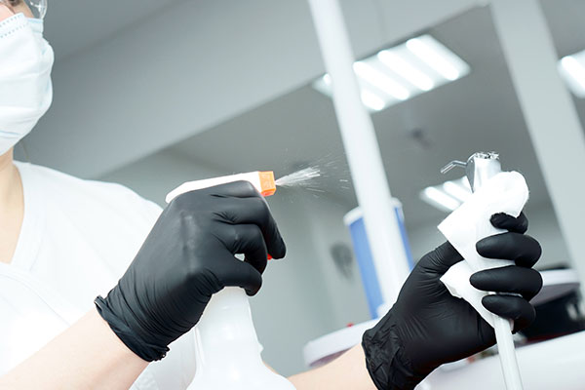
LEAVE FOR STATED TIME

Slide 64
MICROBIAL RESISTANT TO KILLING
Prion
Sterilization Bacterial Endospore
Fungal Spore
Intermediate Mycobacteria – Mycobacterium Tuberculosis
Level Disinfection Nonlipid or small viruses (non enveloped) polio, virus, enterovirus
Fungi
Low level Vegetative bacteria- Pseudomonas, Staphylococcus aureus
Hospital Lipid (enveloped) or medium-sized viruses – Herpes simplex virus, hepatitis A, B
Disinfection and C virus, HIV, Ebola, SARS CoV-2
SURFACES

Slide 65
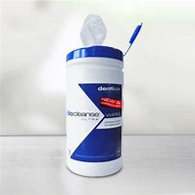
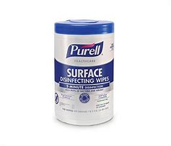
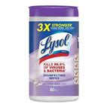
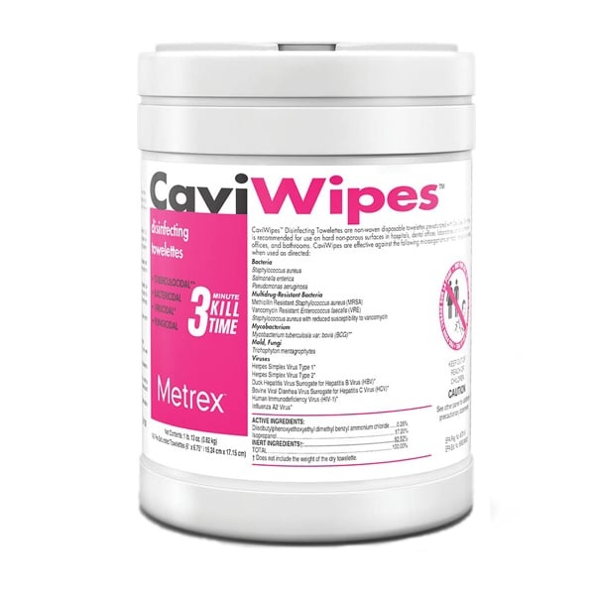
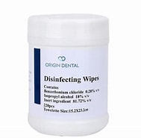
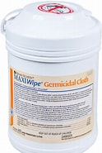
What is the active ingredient??? What product clean best?? What is the contact time???

Slide 66
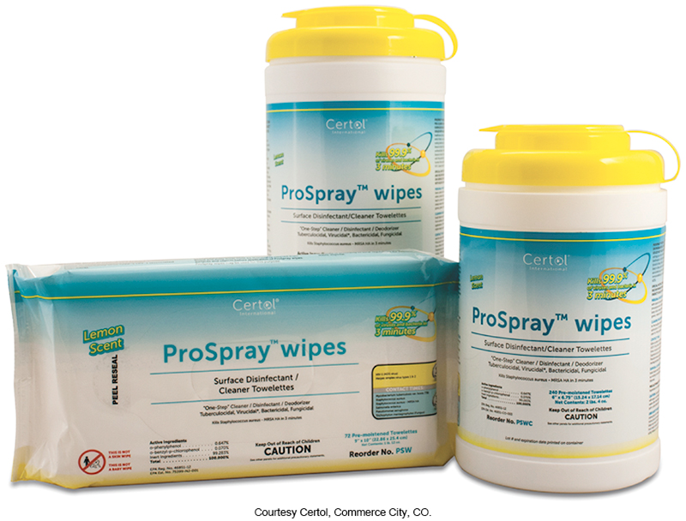
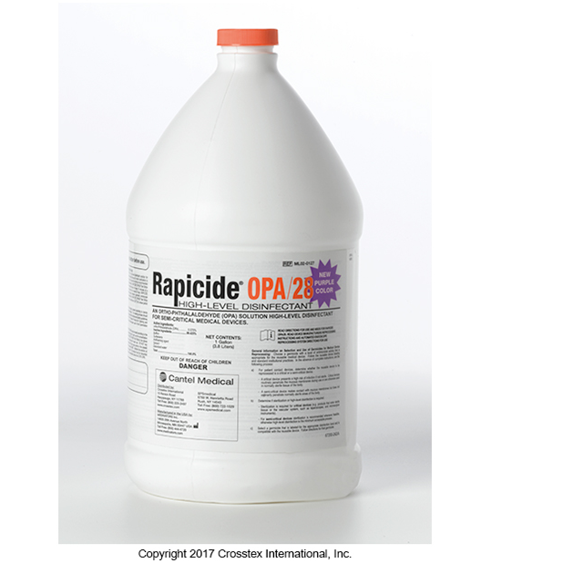
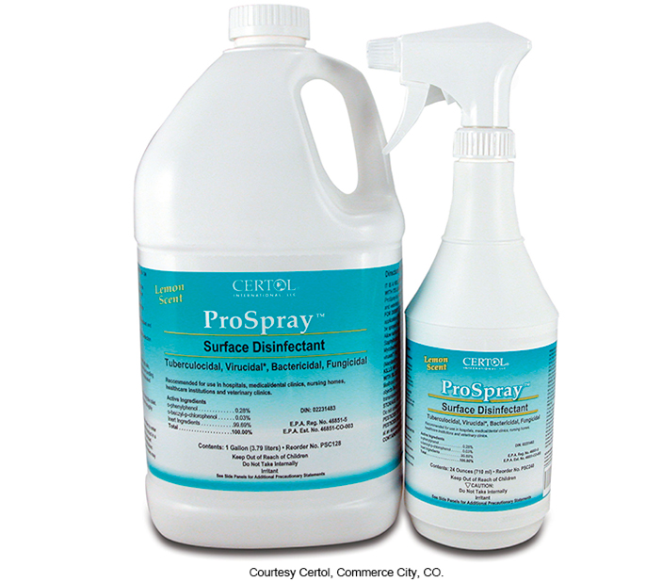
Germicidal disposable wipes with tuberculocidal activity
Synthetic phenol disinfectant.
EPA is classified as a high-level disinfectant.
Alcohol

Slide 67
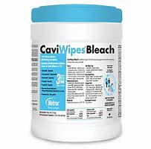
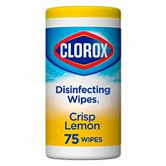
ONE OFFICE…… TOO MANY PRODUCT
Not all product clean the same.
A product with more water less alcohol is going to dissolve proteins more easily and clean things more easily.
A product with high alcohol had a chance of fixing protein to surface depending on the product.
With those more alcohol products is even more important that the cleaning steps are complete.
MAKING OWN WIPES???
The problem is that may not be variable some periods of time. It could degrade the chemical disinfectant. Use all right a way do not store it.
When buying a wipes, there is a lot of testing that the wipe is compatible in time with the chemistry of the disinfectant.

Slide 68
ULTRAVIOLATE GERMICIDAL IRRADIATION
Targets air & surfaces
Directional (shadows)
Must vacate room at higher doses
Efficacy requires specific dosage, airflow, time
Lights degrade over time

Slide 69
The Next Level of Dental Protection
Intraoral aerosol management
Extraoral Aerosol management
Indoor air quality

Slide 70
Routes of Disease Transmission
Direct contact (contact with microorganisms at the source, e.g., the patient’s mouth, handshake)
Indirect contact (contact with an infected object, e.g., contaminated instruments, door handle, and surfaces)
Droplet transmission coming in contact with droplets form infected person (i.e. saliva droplets from a sneeze)-5 microns
Airborne (inhalation of evaporated droplets containing microorganisms that remain in the air coming from an infected person, i.e., aerosols, sharing room and breathing the same air)

Slide 71
Breaking the Chain of Infection
Ventilation
Filtration
Air disruption
Disinfection technologies

Slide 72
Aerosol and Aerosol Management

Slide 73
Viruses' “life” on Surfaces
Number of hours similar viruses to SAR-oV-2 live on surfaces.

Slide 74
Benefits if Air Purification/Ventilation
Overall wee-being and health of the dental team
Patient health and wellness
Positive patient impressions of the dental practice
Increased productivity
Decreased absenteeism

Slide 75
EPA Steps in Controlling Air Pollutants
1. Source Control – where are we creating the aerosol, how do we control the source.
2. Ventilation – clear the pathway on the patient or dental professionals
3. Air Cleaning

Slide 76
Aerosol and Aerosol Management
Source

Slide 77
Ventilation and Air Purification
Ventilation & Air Cleaning – local and centralized

Slide 78
Maintaining Ventilation Systems
Limit the use of demand-controlled ventilation (triggered by temperature setpoint and/or by occupancy controls) during occupied hours and when feasible, up to 2 hours post occupancy to assure that the ventilation rate does not automatically change. Run bathroom exhaust fans continuously during business hours.
Consider the use of a portable high-efficiency particulate air (HEPA) air filtration unit while the patient is undergoing, and immediately following, an aerosol generating procedure.
Rather than just relying on the building’s HVAC system capacity, use a HEPA air filtration unit to reduce aerosol concentrations in the room and increase the effectiveness of the turnover time.

Slide 79
Instruments Processing

Slide 80
Classification of Instruments (Slide 1 of 2)
Critical instruments
Items used to penetrate soft tissue or bone
Greatest risk of transmitting infection and must be sterilized by heat
Semicritical instruments
Touch mucous membranes or nonintact skin
Lower transmission risk
Sterilized by heat or receive minimum high-level disinfection if not heat tolerant
Notes:
What are some examples of critical instruments? (Forceps, scalpels, bone chisels, scalers, and burs)
A fundamental rule of infection control states, “If an item can be heat-sterilized, it should be heat-sterilized.”

Slide 81
Classification of Instruments (Slide 2 of 2)
Noncritical instruments
Contact only intact skin
Low risk of infection transmission
Cleaned and processed with EPA-registered intermediate- or low-level disinfectant
Notes:
Noncritical clinical devices include the position indicator device (PID) of the x-ray unit tube head, the lead apron, and the curing light that comes into contact only with intact skin.

Slide 82
Semi-critical Items Special Considerations—Dental Handpieces
Follow manufacturer’s instructions to safely reprocess dental handpieces and accessories (e.g., low-speed motor, reusable prophylaxis angles).
Clean and heat sterilize between patient uses.
Do not subject the handpiece to high-level disinfection and do not simply wipe the surface with a low-level disinfectant

Slide 83
Semi-critical Items Special Considerations—Digital Sensors
Follow manufacturer’s instructions to safely reprocess digital radiography equipment.
Ideally, barrier protection should be used, followed by cleaning and heat sterilization or high-level disinfection between patients.
If the item cannot tolerate these procedures, then at minimum, barrier protection should be used, followed by cleaning and disinfection with an intermediate-level disinfectant between patients.

Slide 84
Steps in the Processing Instruments
Cleaning
Packaging
Disinfection / Sterilization
Monitoring
Storage

Slide 85
Transporting and Processing Contaminated Patient Care Items
The dental assistant may be exposed to microorganisms through contact with contaminated instruments or other patient care items
Exposure can occur through percutaneous injury (e.g., needle sticks, cuts) or contact with the mucous membranes of the eyes, nose, or mouth
Notes:
Proper PPE must be worn during transport. A proper rigid, leakproof container must also be used to transport contaminated items.
Care must be taken during cleaning, packaging, and sterilization to avoid injury or exposure.

Slide 86
Protection in Transport

Slide 87
Cleaning

Slide 88
Packaging Instruments
Before sterilization, the instruments should be wrapped or packaged to protect them from becoming contaminated after sterilization
When instruments are sterilized without being packaged, they are exposed to the environment as soon as the sterilizer door is opened
They can be contaminated by aerosols in the air, dust, improper handling, or contact with nonsterile surfaces
Additional advantage to packaging instruments is they can be grouped into special setups, such as crown/bridge, amalgam, prophylactic, or composite
Notes:
The preparation and packaging area should have counter space and storage space for sterilized instruments, fresh disposable supplies, and prepared trays or instrument cassettes.
Refer to Figure 21.4.

Slide 89
Steam Autoclave Sterilization
Dental office steam sterilizers usually operate in four cycles
Heat-up cycle
Sterilizing cycle
Depressurization cycle
Drying cycle

Slide 90
Sterilization Monitoring: Types of Indicators
Mechanical: Measures time, temperature, and pressure.
Chemical: Change in color when physical parameter is reached.
Biological (spore tests):
- Uses biological spores to assess the sterilization process directly.
Indicators are specific to the type of sterilization used.

Slide 91
Dental Unit Waterlines

Slide 92
CDC Recommendations for Dental Unit Water Quality
Use water that meets US Environmental Protection Agency (EPA) regulatory standards for drinking water (i.e., <500 CFU/mL of heterotrophic water bacteria) for routine dental treatment output water.
Consult with the dental unit manufacturer for appropriate methods and equipment to maintain the recommended quality of dental water.
Follow recommendations for monitoring water quality provided by the manufacturer of the unit or waterline treatment product.

Slide 93
CDC Recommendations for Dental Unit Water Quality (cont.)
Discharge water and air for a minimum of 20–30 seconds after each patient, from any device connected to the dental water system that enters the patient’s mouth (e.g., handpieces, ultrasonic scalers, air or water syringes).
Consult with the dental unit manufacturer on the need for periodic maintenance of anti-retraction mechanisms.

Slide 94
Why Does Bacteria Grow So Quickly in DUWL?
Biofilms serve as microbial reservoir
Brand new waterlines can grow 200,000 CFU/mL in less than 5 days
Every time the air/water syringe is used, it’s like blowing on a dandelion, spreading little seeds down the line.

Slide 95
Dental Unit Waterlines and Biofilm
Microbial biofilms form in narrow-bore tubing of dental units.
Biofilms serve as a microbial reservoir.
Primary source of microorganisms is municipal water supply.

Slide 96
Improving Dental Unit Water Quality
Available Technology
- Independent reservoirs.
- Chemical treatment.
- Filtration.
- Combinations of technologies.
- Sterile water delivery systems.
DHCP should always consult with the dental unit manufacturer for appropriate methods to maintain the recommended dental unit water quality.

Slide 97
3 Steps to Safe Water
The Proven Protocol
Shock first, quarterly, & whenever testing reveals ≥200 CFU/mL
Use a continuous maintenance product (Tablets or Straws)
Test quarterly – if failure, shock and retest

Slide 98
Manufacturers IFU have recently changed

Slide 99
Water testing kit

Slide 100
Sterile Irrigating Solutions
Use sterile saline or sterile water as a coolant/irrigator when performing surgical procedures.
Use devices designed for the delivery of sterile irrigating fluids.

Slide 101
New Requirements of SB 1453 Become Effective January 1, 2025
Changes in Allowable Duties
Unlicensed dental assistants may now perform coronal polishing once they successfully complete a Board-approved course.
Completion of a Board-approved pit and fissure sealants course is now required to apply for RDA licensure.
Stricter Requirement to Complete Infection Control Course
All dental assistants must now complete a Board-approved 8-hour course in infection control prior to performing any basic supportive dental procedures involving potential exposure to blood, saliva, or other potentially infectious materials.

Slide 102
CONTINUING EDUCATION SCHOOL FOR DENTISTRY (RP 6044)
APPROVED COURSES
8 HOURS INFECTION CONTROL
2 HOURS DENTAL PRACTICE ACT
DENTAL RADIATION SAFETY
CORONAL POLISHING
PIT AND FISSURE SEALANT
dentalcecourses23@gmail.com
(714) 851-4079

Slide 103
Thank you !!!

